Slide 1
API
.NET Development

Slide 2

API?
Application Programming Interface
APIs let your service communicate with other services without having to know how they’re implemented or forcing you to constantly build new connectivity infrastructure.
APIs simplify how developers integrate new application components into an existing architecture
APIs are sometimes thought of as contracts, with documentation that represents an agreement between parties: If party 1 sends a remote request structured a particular way, this is how party 2’s software will respond.
This can simplify app development, saving time and money.
https://www.redhat.com/en/topics/api

Slide 3
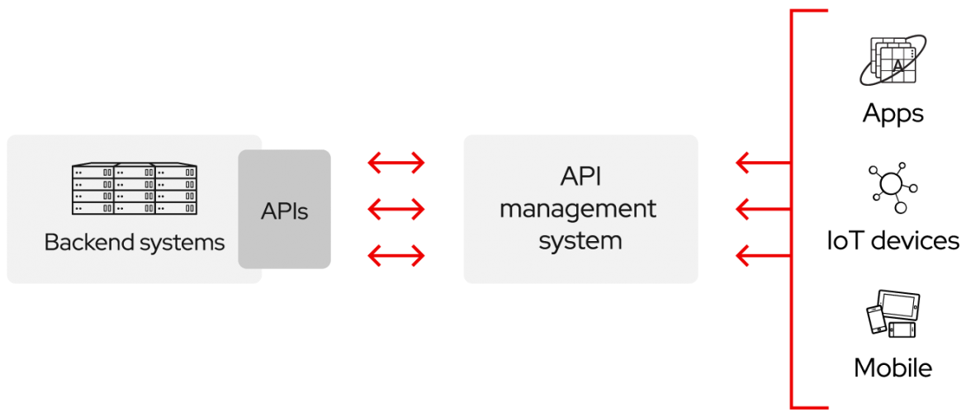
API?
APIs are about integration: the connection of data, applications, and devices across your IT organization so that all of your technologies can better communicate and work together.
https://www.redhat.com/en/topics/api
Notes:
https://www.redhat.com/en/topics/api/what-are-application-programming-interfaces

Slide 4
Why open your data for external use?
APIs are a simplified way to connect your own infrastructure through cloud-native app development, but they also allow you to share your data with customers and other external users.
Public APIs represent unique business value because they can simplify and expand how you connect with your partners, as well as potentially monetize your data because now external software developers can build apps based on your data.
Popular examples of public APIS:
Google Maps API – Google Translate API - …
Spotify API - Deezer API - ITunes API – Shazam API - …
Instagram API – Twitter API – Facebook API - …
IMDB
https://rapidapi.com/collection/popular-apis
Backend for your own application
REST – HTTP - JSON
https://www.redhat.com/en/topics/api

Slide 5
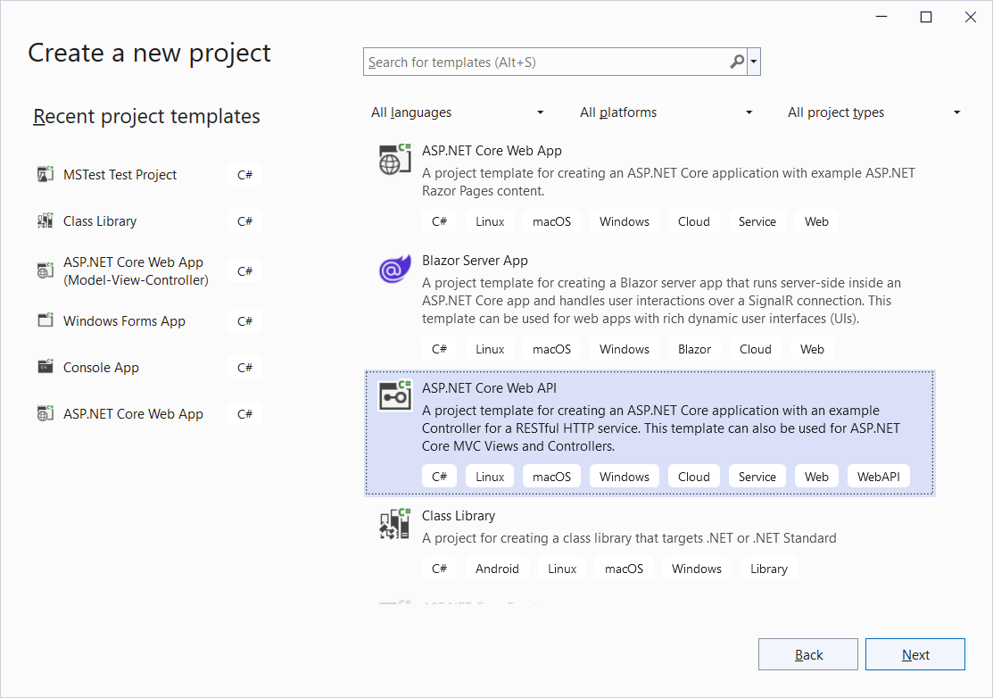
Create new ASP.NET Core Web API project
Create new Project

Slide 6
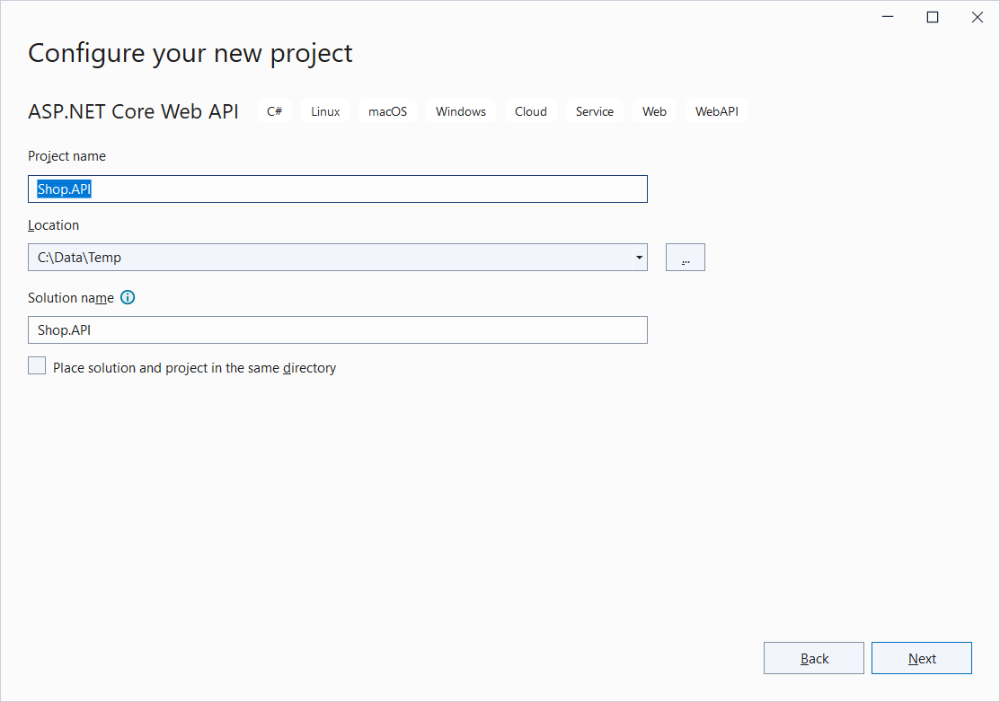
Create new ASP.NET Core Web API project
Project name: Shop.API

Slide 7
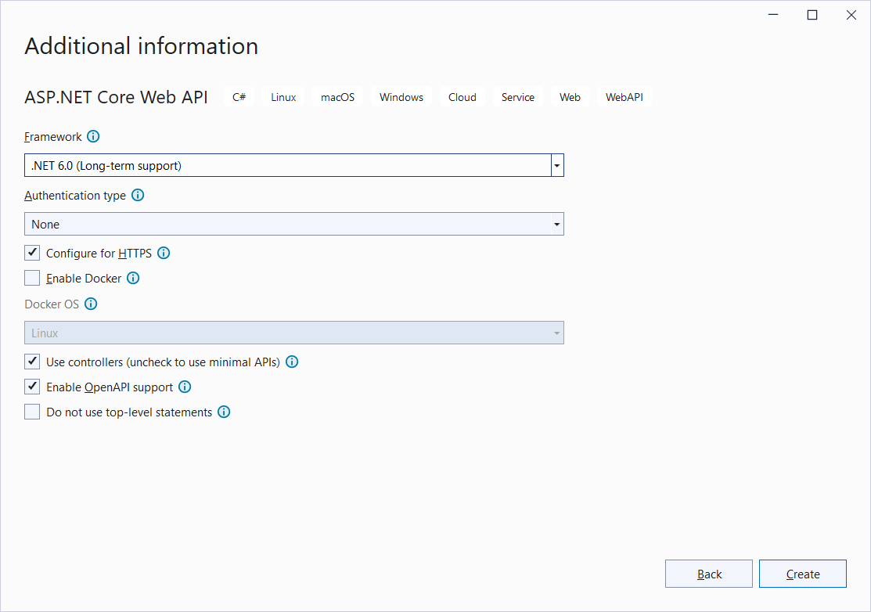
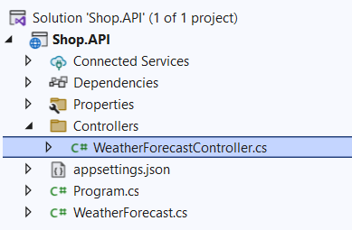
Create new ASP.NET Core Web API project
.NET 6.0
Configure for HTTPS
No Docker support
Enable OpenAPI support

Slide 8
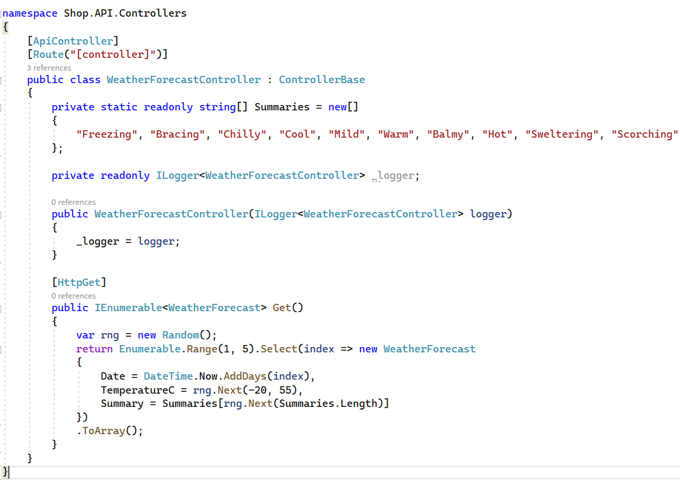
API : Collection of APIControllers
v
v
[HttpGet] → REST Endpoint
Returns collection with 5 WeatherForecast objects with random property values
Notes:
What is REST? REpresentational State Transfer
Rest is resource based. A resource is a customer, an order, an invoice, …. It is the URI of the request.
These resources are accessed with actions (http-verbs like get/post/put/delete)
Finally, a representation of the resource (e.g. Person) is transferred from server to client in JSON or XML (Name, address, phone number)
The transfer itself is an http-response containing a status (200 successful/ 204 successful but no content/ 400 bad request/ 404 not found ) and a body.
https://www.restapitutorial.com/lessons/whatisrest.html

Slide 9
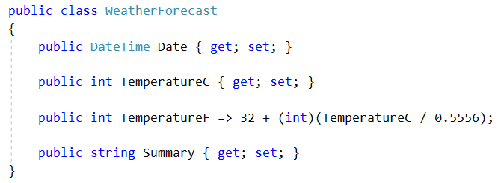
WeatherForecast

Slide 10
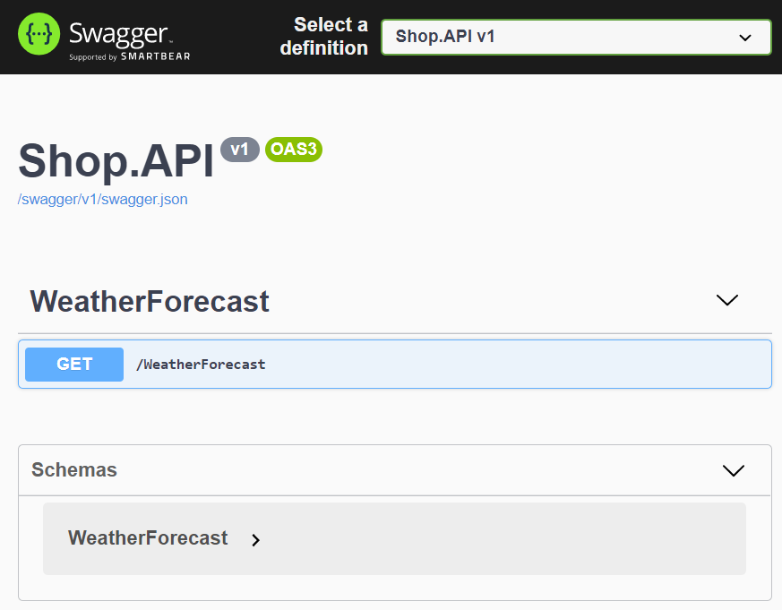
Test default API
Ctrl + F5
SwaggerUI
Web interface to test REST APIs
Each public action method in your controller can be tested
GET methods can be tested in your browser as well
Without Swagger, you need an extra tool like PostMan
to test your POST, DELETE, PUT methods
Notes:
https://docs.microsoft.com/en-us/aspnet/core/tutorials/web-api-help-pages-using-swagger?view=aspnetcore-6.0
OpenAPI is a language-agnostic specification for describing REST APIs. It allows both computers and humans to understand the capabilities of a REST API without direct access to the source code. Its main goals are to:
Minimize the amount of work needed to connect decoupled services.
Reduce the amount of time needed to accurately document a service.
In short:
OpenAPI is a specification.
Swagger is tooling that uses the OpenAPI specification. For example, OpenAPIGenerator and SwaggerUI.
The OpenAPI specification is a document that describes the capabilities of your API. The document is based on the XML and attribute annotations within the controllers and models. It's the core part of the OpenAPI flow and is used to drive tooling such as SwaggerUI.
Swagger UI offers a web-based UI that provides information about the service, using the generated OpenAPI specification. Each public action method in your controllers can be tested from the UI. Select a method name to expand the section. Add any necessary parameters, and select Try it out!.

Slide 11
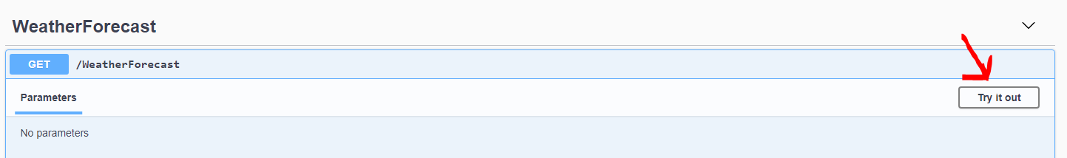
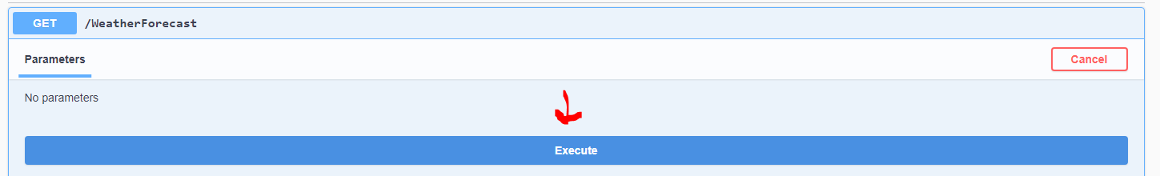
Test default API

Slide 12
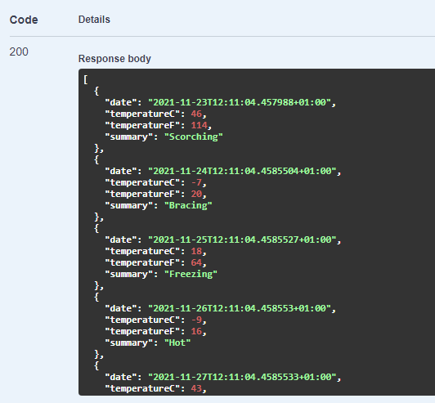
Test default API
Response: HTTP 200 status code indicates that the request has succeeded.
Collection with 5 WeatherForecast objects is returned

Slide 13
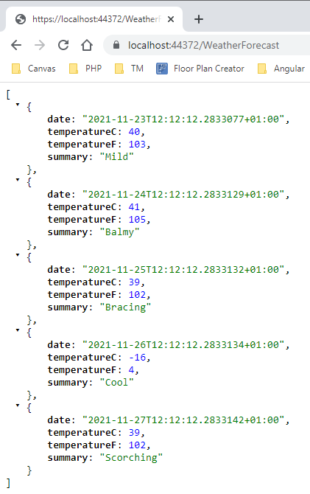
Test default API
Without Swagger (only GET)
https://localhost:44372/WeatherForecast
Notes:
Port settings can be different. See folder Properties/launchsettings.json

Slide 14
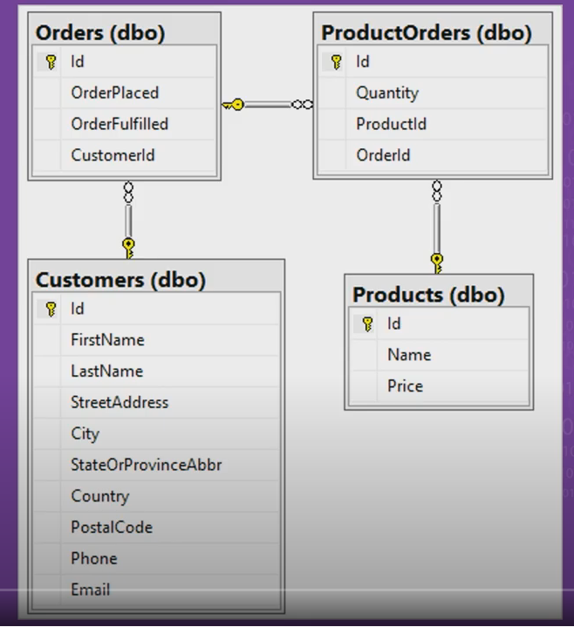
Goal
Build API
Data: shop
Database: local SQL server

Slide 15
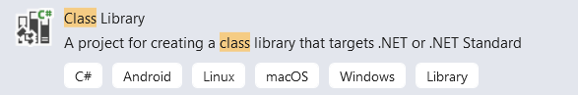
DAL Project (Models, REPO, UOW)
To maintain a well-structured overview, all data access related elements are assembled in a new class library project Shop.DAL
Add new project
Class library – Shop.DAL
.NET 6.0
Add Project Reference in Shop.API to Shop.DAL

Slide 16
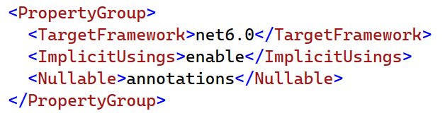
Nullable
Edit the Project file of both projects and set nullable to annotations
Notes:
annotations: The compiler doesn't perform null analysis or emit warnings when code might dereference null.
All new nullable warnings are disabled.
You can use the ? suffix to declare a nullable reference type.
All other reference type variables are non-nullable reference types.

Slide 17
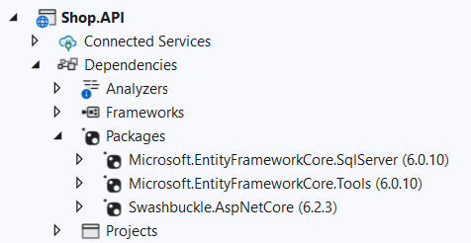
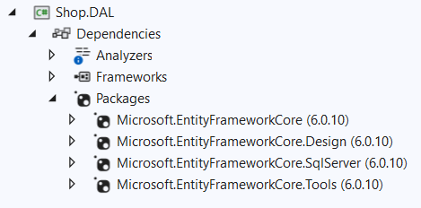
DAL Project (Models, REPO, UOW)
Install the EF Core NuGet packages (SqlServer/Tools) in Shop.API
Install the EF Core NuGet packages (Core/Design/SqlServer/Tools) in Shop.DAL
It is important that both applications use this same version of EF (6.0.10)
Notes:
It is a good idea to install the same version as on the slides. Otherwise your scaffolding in the end could fail.
DO NOT CHOOSE version 7…. The webcodegeneration package is not available in 7… for .NET 6.

Slide 18
Models (in Shop.DAL)
The model collection is a set of classes that represents the data managed by the API
Our models
Product
Customer
Order
ProductOrder
Create classes for these models in a new Models
folder in Shop.DAL
(copy from resources on Canvas)

Slide 19
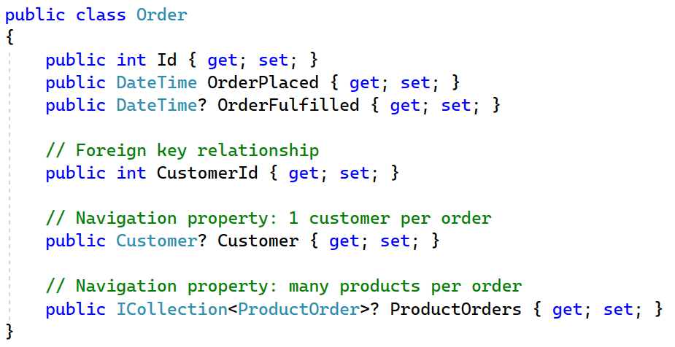
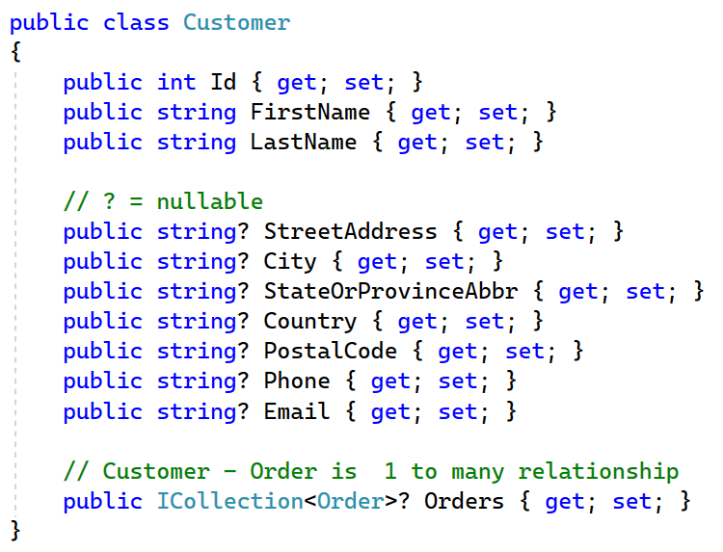
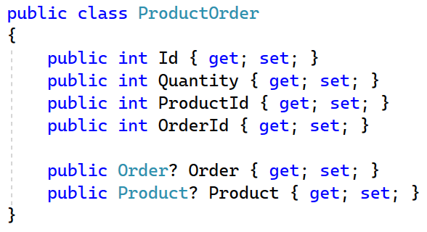
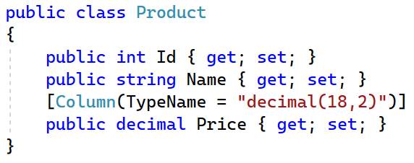
Models (in Shop.DAL)

Slide 20
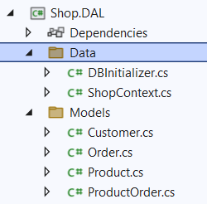
Database context (in Shop.DAL)
Create a new folder ‘Data’ in Shop.DAL
Create the DbContext ‘ShopContext.cs’ in this folder (copy from resources, DBInitializer as well)
Through this ShopContext we want to query and update the database (connection injected in the constructor)
public ShopContext(DbContextOptions<ShopContext> options)
In the ShopContext DBSets are created for the models
public DbSet<Customer> Customers { get; set; }
The mapping to the actual tables in SQLServer is set
modelBuilder.Entity<Customer>().ToTable("Customer");

Slide 21
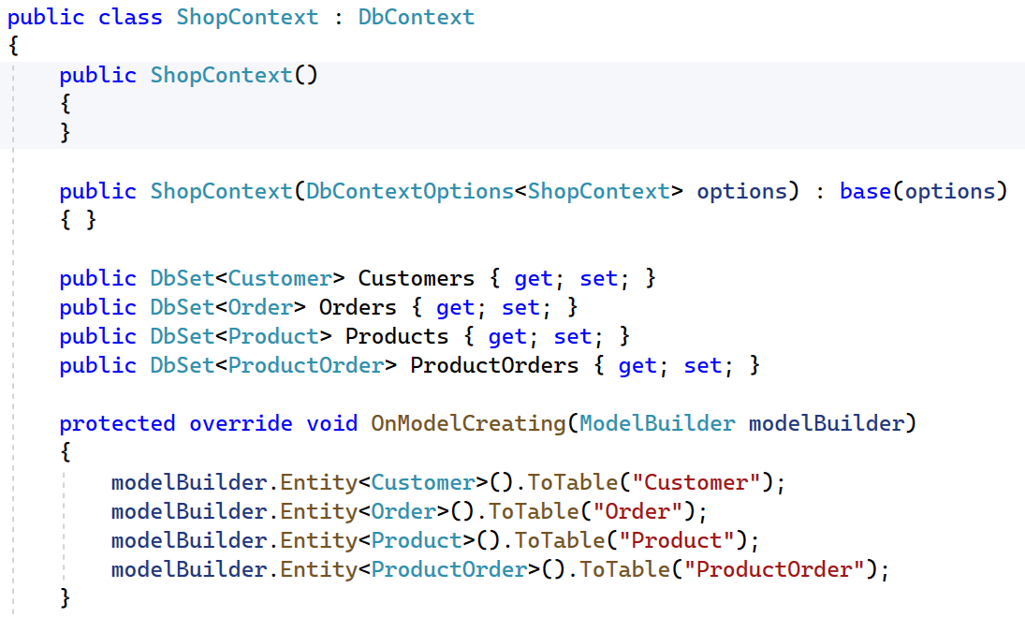
ShopContext.cs (in Shop.DAL)
// empty constructor, otherwise scaffolding won't work
Notes:
Microsoft.EntityFrameworkCore.Relational (Needed to be added in DAL by some students)
Microsoft.EntityFrameworkCore
Microsoft.EntityFrameworkCore.SqlServer

Slide 22
Register the database context (in Shop.API)
Shop.API Project | Program.cs
using Microsoft.EntityFrameworkCore;
using Shop.DAL.Data;
var builder = WebApplication.CreateBuilder(args);
// Add services to the container.
var connectionString
= builder.Configuration.GetConnectionString("DefaultConnection");
builder.Services.AddDbContext<ShopContext>(options =>
options.UseSqlServer(connectionString));
Notes:
using Microsoft.EntityFrameworkCore;
using Shop.DAL.Data;
var builder = WebApplication.CreateBuilder(args);
// Add services to the container.
var connectionString
= builder.Configuration.GetConnectionString("DefaultConnection");
builder.Services.AddDbContext<ShopContext>(options =>
options.UseSqlServer(connectionString));

Slide 23
appsettings.json
Add ConnectionStrings Add DefaultConnection key-value pair
{
"ConnectionStrings": {
"DefaultConnection": ""
},
"Logging": {
"LogLevel": {
"Default": "Information",
"Microsoft.AspNetCore": "Warning"
}
},
"AllowedHosts": "*"
}

Slide 24
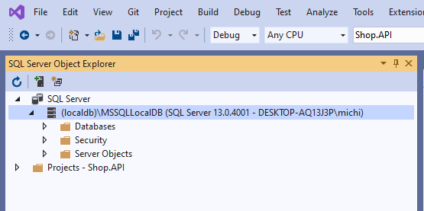
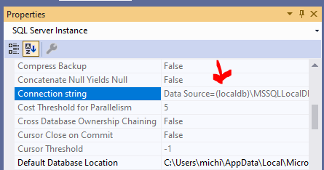
Get the connectionstring
Right click (localdb)\MSSQLLocalDB and choose ‘Properties’
Copy the connection string

Slide 25
DefaultConnection (in Shop.API)
Paste the retrieved connection string
Change Initial Catalog from master to ‘ShopAPI’ = database name
{
"ConnectionStrings": {
"DefaultConnection": "Data Source=(localdb)\\MSSQLLocalDB;Initial Catalog=ShopAPI;Integrated Security=True;Connect Timeout=30;Encrypt=False;TrustServerCertificate=False;ApplicationIntent=ReadWrite;MultiSubnetFailover=False"
},
"Logging": {
...

Slide 26
Connectionstring for scaffolding (Shop.DAL)
ShopContext.cs
protected override void OnConfiguring(DbContextOptionsBuilder optionsBuilder)
{
if (!optionsBuilder.IsConfigured)
{
optionsBuilder.UseSqlServer("Data Source=(localdb)\\MSSQLLocalDB;Initial Catalog=ShopAPI;Integrated Security=True;Connect Timeout=30;Encrypt=False;TrustServerCertificate=False;ApplicationIntent=ReadWrite;MultiSubnetFailover=False");
}
}

Slide 27
DBInitializer
Shop.DAL
Copy DBInitializer.cs from the resources in the Data folder
Shop.API | Program.cs
Execute the Initialize method of the DBInitializer
using (var scope = app.Services.CreateScope())
{
var myContext = scope.ServiceProvider.GetRequiredService<ShopContext>();
DBInitializer.Initialize(myContext);
}
app.Run();
Notes:
using (var scope = app.Services.CreateScope())
{
var myContext = scope.ServiceProvider.GetRequiredService<ShopContext>();
DBInitializer.Initialize(myContext);
}

Slide 28
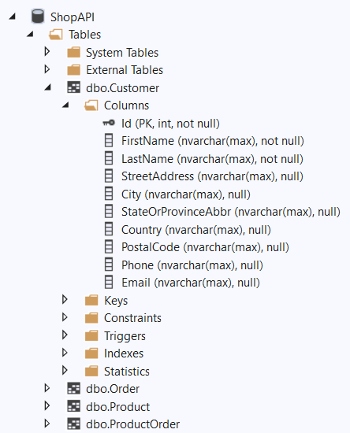
Create the database
Start your application to check if your database is created

Slide 29
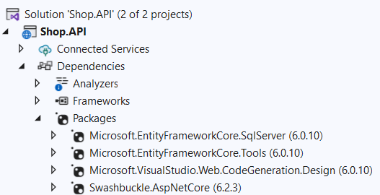
Add a controller (in Shop.API)
Before you can use scaffolding make sure the Web.CodeGeneration.Design library (6.0.10) is available
If not, Manage NuGet packages
Notes:
6.0.10 is compatible with .NET 6
7. … is only compatible with .NET 7 (you cannot use that one)

Slide 30
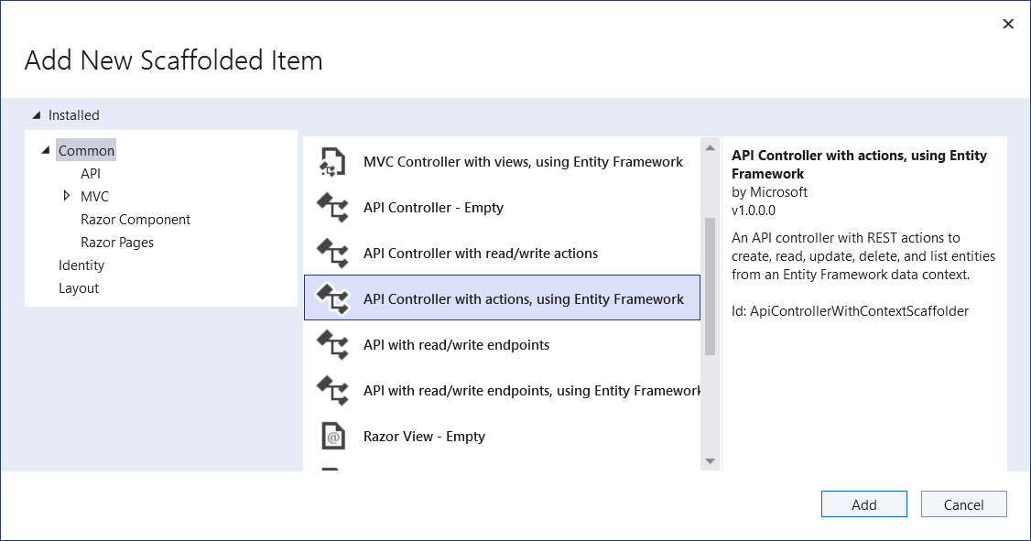
Add a controller (in Shop.API)
Richt click ‘Controllers’ folder – Add New Scaffolded item – API Controller with actions, using EF:

Slide 31
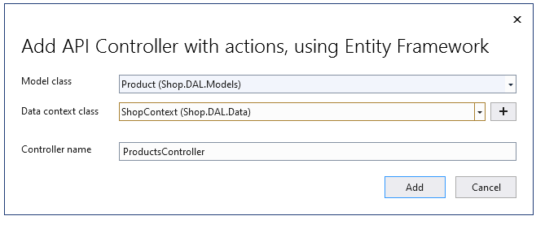
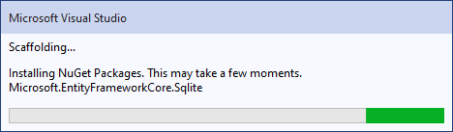
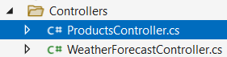
Add a controller for product (in Shop.API)

Slide 32
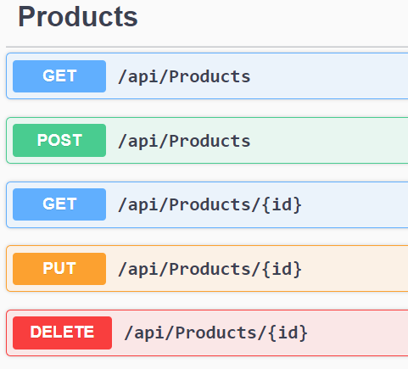
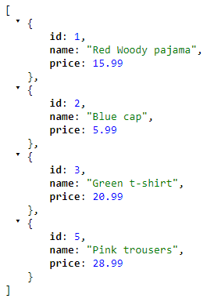
ProductsController
Ready to go! Ctrl + F5 (Swagger)
Try out the GET (Swagger)
Or: https://localhost:44372/api/products
REST

Slide 33
ProductsController - REST
HTTP | Action method | Result
[HttpGet] | GetProducts() | Returns all the products
[HttpGet("{id}")] | GetProduct(int id) | Returns a specific product based on the id
[HttpPut("{id}")] | PutProduct(int id, Product product) | Updates a product
[HttpPost] | PostProduct(Product product) | Adds a product
[HttpDelete("{id}")] | DeleteProduct(int id) | Deletes a product based on the id

Slide 34
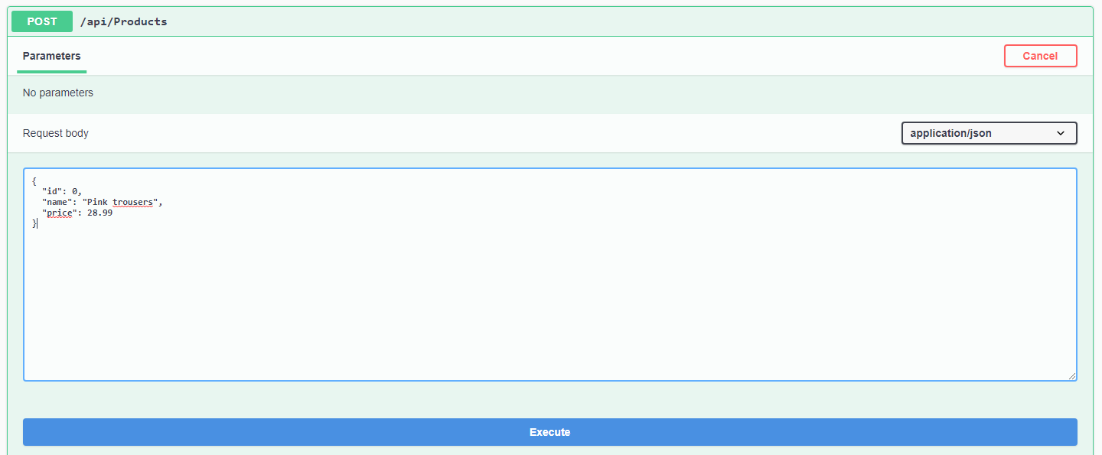
Swagger - Post
POST a new product!
{
"id": 0,
"name": "Pink trousers",
"price": 28.99
}
Product id stays 0 The id will be generated

Slide 35
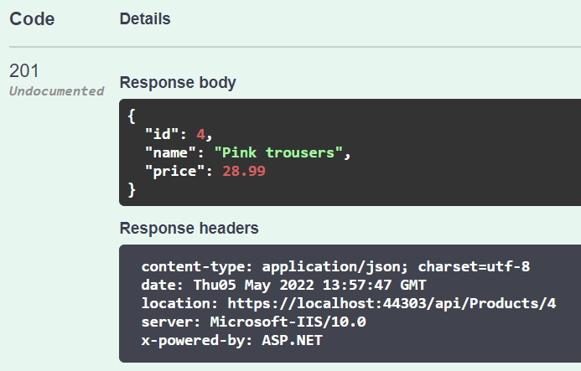
Swagger – Post - Result
Product id is automatically set

Slide 36
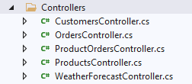
More controllers
Create the controllers for the other models via scaffolding

Slide 37
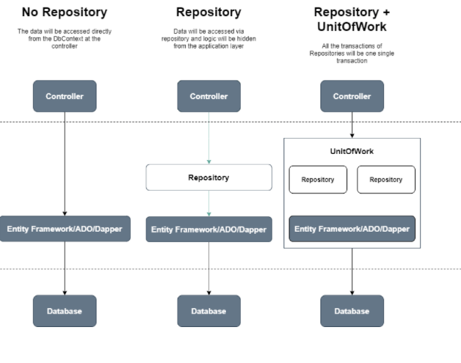
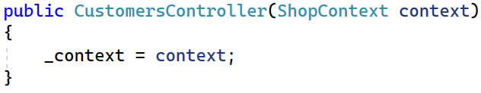
Repository & UnitofWork (UoW)
Generating these controllers results in the ‘ShopContext’ directly injected in the constructor of the controller.
This is NOT what we want.
→ Let’s implement the Repository
and UoW Data Access patterns

Slide 38
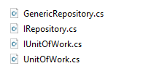
Repository & UoW
Find the following files in the Resources folder and copy them to the root folder of the Shop.DAL project:

Slide 39
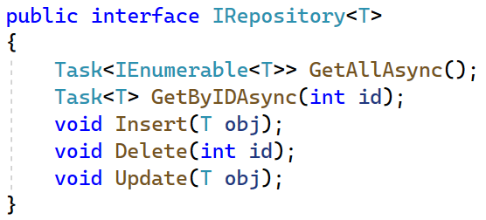
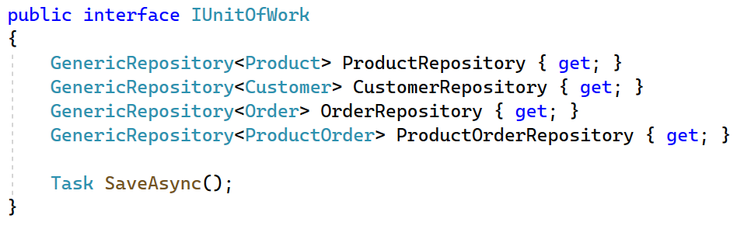
Repository & UoW
Notice that these interfaces and classes work asynchronously:

Slide 40
Repository & UoW
Do not forget to register the UoW interface + implementation in Program.cs (in Shop.API)
builder.Services.AddScoped<IUnitOfWork, UnitOfWork>();
Refactor the ProductsController so that this works with the UnitOfWork
Notes:
Using Shop.DAL

Slide 41
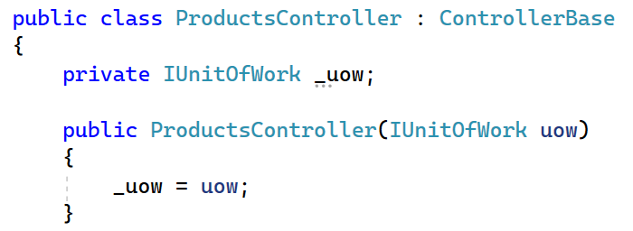
Make the ProductsController work with UOW
Because we scaffolded the controllers all the actions work asynchronously.

Slide 42
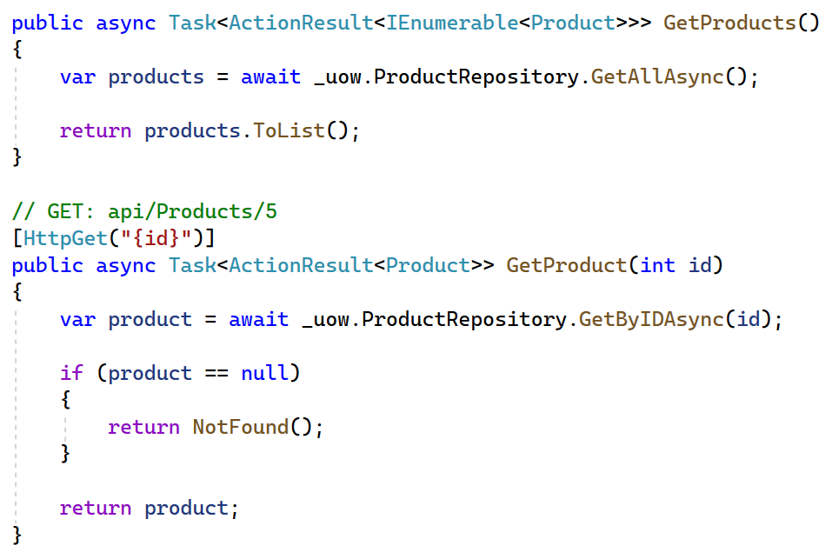
Make the ProductsController work with UOW

Slide 43
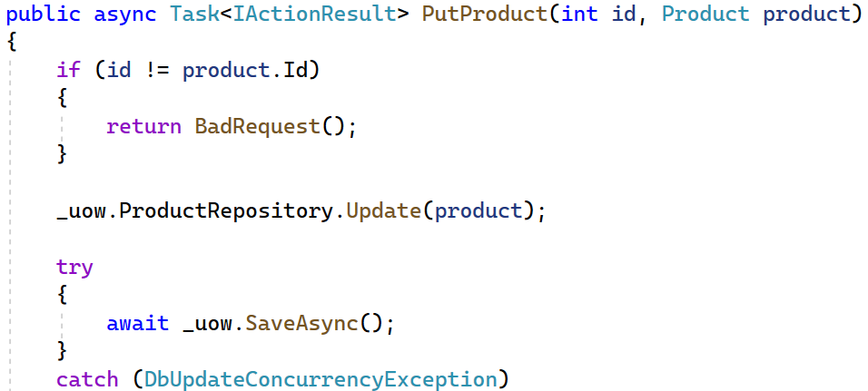
Make the ProductsController work with UOW

Slide 44
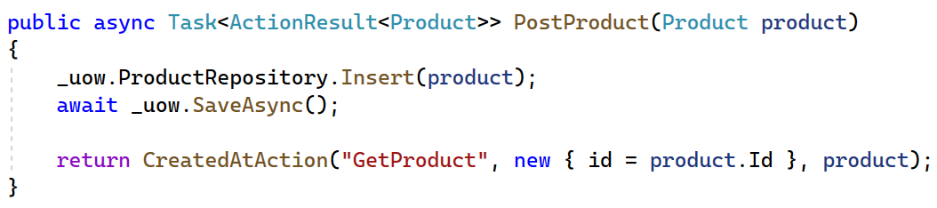
Make the ProductsController work with UOW
Notes:
CREATEDATACTION()
In contrast to other methods (Ok, NotFound, BadRequest), they create a response with status code 201 CREATED and a Location header. Response includes a Location header with an URI that can be used to retrieve newly created resource.
They accept an object as the last parameter, this object will be returned as a response body. Usually, it is just the value of newly created resource.
actionName - by default it is controller method name but can also be assigned using [ActionName("...")] attribute
(controllerName - name of the controller where our action resides)
routeValues - info necessary to generate a correct URL, for example, path or query parameters
value - content to return in a response body

Slide 45
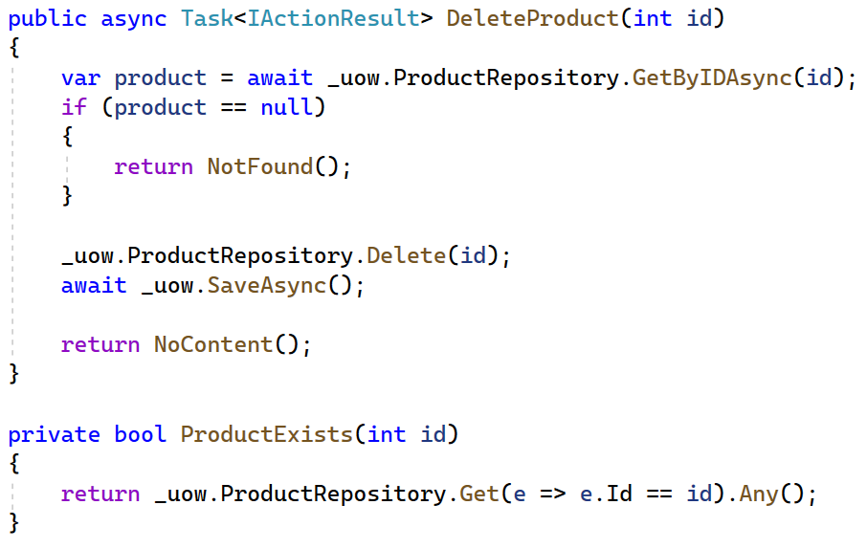
Make the ProductsController work with UOW

Slide 46
Make the CustomersController work with UOW
Try it yourself!

Slide 47
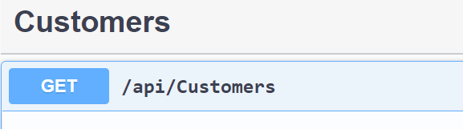
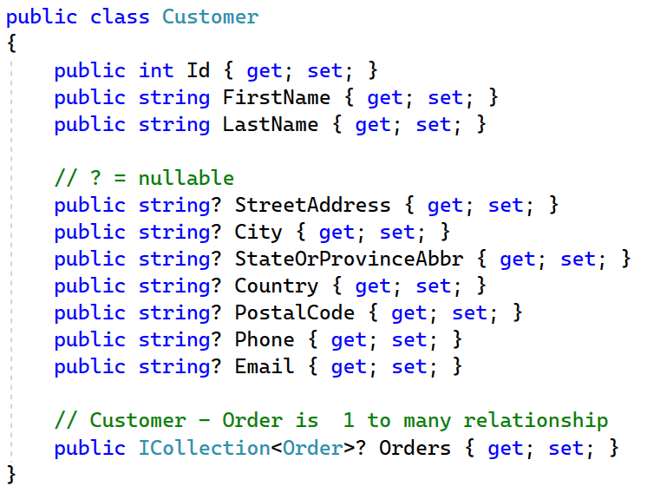
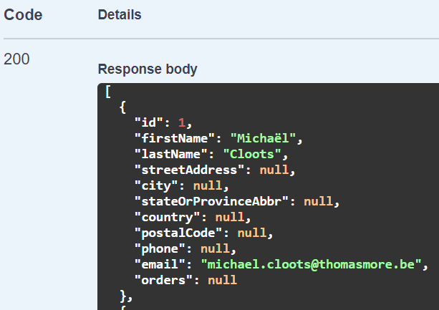
Run and test
Run the API (Ctrl + F5) Test Customers GET using Swagger

Slide 48
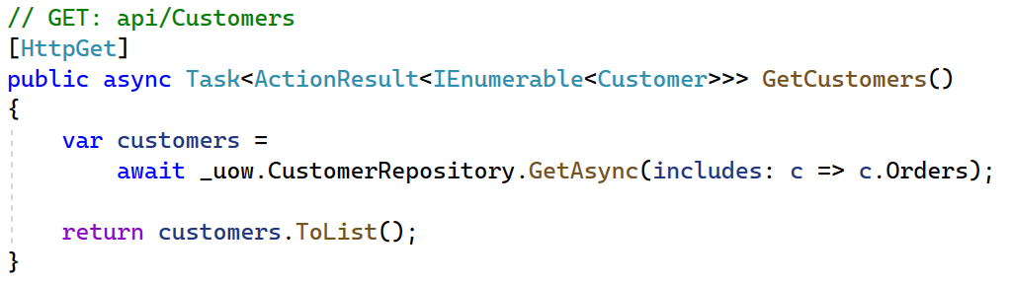
Customer - Order
Corresponding orders (a customer has 0 - * orders) are not loaded.
Include the orders in the GetCustomers() method

Slide 49

Run and test
Test Customers GET using the Swagger interface
Circular reference detected!
Notes:
We try to serialize an object using Newtonsoft.Json but there’s a circular reference (Parent – Child – Parent). The Parent object Customer has a reference to a Child object Order, which has a back reference to the Parent object Customer.

Slide 50
Circular Reference

Slide 51
Solution for avoiding object cycles
Go to Program.cs in Shop.API
using System.Text.Json.Serialization;
Add
builder.Services.AddControllers();
builder.Services.AddControllers().AddJsonOptions(x => x.JsonSerializerOptions.ReferenceHandler = ReferenceHandler.Preserve);
Notes:
builder.services.AddControllers().AddJsonOptions(x => x.JsonSerializerOptions.ReferenceHandler = null);
builder.services.AddControllers().AddNewtonsoftJson(x => x.SerializerSettings.ReferenceLoopHandling = Newtonsoft.Json.ReferenceLoopHandling.Ignore);

Slide 52

Result – GetCustomers()
Customer and corresponding orders are loaded.

Slide 53
Post a new customer
Try to use swagger to add a customer to the database
Next create an order for this customer

Slide 54



Consume the API with javascript
Add new .NET ASP.NET Core Web app to your solution
(NOT MVC in this demo)

Slide 55


Consume the API with javascript
Replace the code in index.cshtml (resources on canvas)

Slide 56

Consume the API with javascript
Make sure that both applications are running!
Solution | Set Startup Projects …

Slide 57

Consume API with javascript
Issue: CORS request was blocked

Slide 58


CORS
Open Properties|Launchsettings for each application:
App = localhost:XXXX
API = localhost:YYYY
Different domains cause trouble!
Security errors when calling API in App
Cross-Origin Resource Sharing is a way to solve this

Slide 59
Program.CS (Shop.API)
Before var app = builder.Build()
Before app.mapcontrollers()
builder.Services.AddCors(options => { options.AddDefaultPolicy(builder => builder.AllowAnyOrigin() .AllowAnyHeader() .AllowAnyMethod()); } );
builder.Services.AddCors(options => { options.AddDefaultPolicy(builder => builder.WithOrigins("https://localhost:7185") .AllowAnyHeader() .AllowAnyMethod()); } );
app.UseCors()

Slide 60

Result after configuring CORS
Customer data are loaded via the API

Slide 61


Securing API by enforcing https
Properties | Launchsettings:
In program.cs:
Each http request is redirected to https
→ Test in browser!

